Slide 1


Git Basics

Slide 2
Initializing a Repository in an Existing Directory
$ git init
This creates a new subdirectory named .git that contains all of your necessary repository files — a Git repository skeleton. At this point, nothing in your project is tracked yet
$ git init <project_name>
If you want to give the repository another name instead of directory name.

Slide 3
Cloning an Existing Repository
$ git clone https://github.com/libgit2/libgit2
That creates a directory named libgit2, initializes a .git directory inside it, pulls down all the data for that repository, and checks out a working copy of the latest version. If you go into the new libgit2 directory that was just created, you’ll see the project files in there, ready to be worked on or used.
$ git clone https://github.com/libgit2/libgit2 mylibgit
If you want to clone the repository into a directory named something other than libgit2, you can specify the new directory name as an additional argument

Slide 4
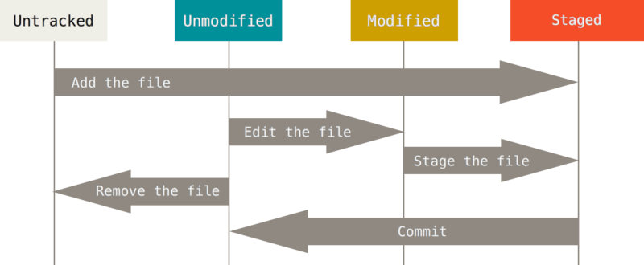

Slide 5
Checking the Status of Your Files
The main tool you use to determine which files are in which state is the git status command

Slide 6
Tracking New Files
In order to begin tracking a new file,
you use the command git add
In order to add new file to git add run the following command
$ git add thisone.txt
To track two or more files follow the command
$ git add thisone.txt thistwo.txt
To Track all the files in the folder.
$ git add .

Slide 7
Tracking New Files
In order to begin tracking a new file,
you use the command git add
In order to add new file to git add run the following command
$ git add thisone.txt
To track two or more files follow the command
$ git add thisone.txt thistwo.txt
To Track all the files in the folder.
$ git add .

Slide 8
Short Status
While the git status output is pretty comprehensive, it’s also quite wordy. Git also has a short status flag so you can see your changes in a more compact way. If you run git status -s or git status --short you get a far more simplified output from the command

Slide 9

Committing Your Changes
Now that your staging area is set up the way you want it, you can commit your changes.
Remember that anything that is still unstaged — any files you have created or modified that you haven’t run git add on since you edited them — won’t go into this commit.
The simplest way to commit is to type git commit
:x for saving the commit message
Alternatively, you can type your commit message inline with the commit command by specifying it after a -m flag
Git commit -m “This is commit message”

Slide 10
...
For Every Commit you do, you see the following information
Which branch you committed to (master).
What SHA-1 checksum the commit has (463dc4f).
How many files were changed, and statistics about lines added and removed in the commit.

Slide 11
Skipping the Staging Area
If you want to skip the staging area, Git provides a simple shortcut. Adding the -a option to the git commit command makes Git automatically stage every file that is already tracked before doing the commit, letting you skip the git add part.
$ git commit -a -m “Commiting skipping the staging area”

Slide 12

Removing Files
To remove a file from Git, you have to remove it from your tracked files (more accurately, remove it from your staging area) and then commit.
The git rm command does that, and also removes the file from your working directory so you don’t see it as an untracked file the next time around.
You may want to keep the file on your hard drive but not have Git track it anymore. This is particularly useful if you forgot to add something to your .gitignore file and accidentally staged it, like a large log file or a bunch of .a compiled files. To do this, use the --cached option

Slide 13

Moving Files
If you want to rename a file in Git, you can run something like:
$ git mv file_from file_to
Run $git status to see the modification.

Slide 14

Viewing the Commit History
You’ll probably want to look back to see what has happened. The most basic and powerful tool to do this is the git log command.
By default, with no arguments, git log lists the commits made in that repository in reverse chronological order. That is, the most recent commits show up first.

Slide 15
...
-p or --patch shows the difference (the patch output) introduced in each commit.
You can also limit the number of log entries displayed, such as using -2 to show only the last two entries.
if you want to see some abbreviated stats for each commit, you can use the --stat option.
--stat option prints below each commit entry a list of modified files, how many files were changed, and how many lines in those files were added and removed. It also puts a summary of the information at the end.

Slide 16
...
$ git log --oneline can be used to get single line commit history
$ git log --oneline -2 can be used to last 2 recent commits in single line.
The oneline and format options are particularly useful with another log option called --graph. This option adds a nice little ASCII graph showing your branch and merge history

Slide 17
Limiting Log Output
The time-limiting options such as --since and --until are very useful.
$ git log --since=2.weeks (we can also specify date)
The --author option allows you to filter on a specific author, and the --grep option lets you search for keywords in the commit

Slide 18
Limiting Log Output
The time-limiting options such as --since and --until are very useful.
$ git log --since=2.weeks (we can also specify date)
The --author option allows you to filter on a specific author, and the --grep option lets you search for keywords in the commit

Slide 19
Undoing Things

Slide 20

Undoing Things
At any stage, you may want to undo something.
If you want to redo that commit, make the additional changes you forgot, stage them, and commit again using the --amend option.
$git commit --amend

Slide 21
...
As an example, if you commit and then realize you forgot to stage the changes in a file you wanted to add to this commit, you can do something like this:
$ git commit -m 'initial commit'
$ git add forgotten_file
$ git commit --amend
You end up with a single commit — the second commit replaces the results of the first.

Slide 22
Unstaging a Staged File
$git reset HEAD <file>... Helps to unstage a particular file after accidentally running $git add *
This command takes the specified file out of the staging area.

Slide 23

Remember, anything that is committed in Git can almost always be recovered. Even commits that were on branches that were deleted or commits that were overwritten with an --amend commit can be recovered. However, anything you lose that was never committed is likely never to be seen again.

Slide 24


